Slide 1
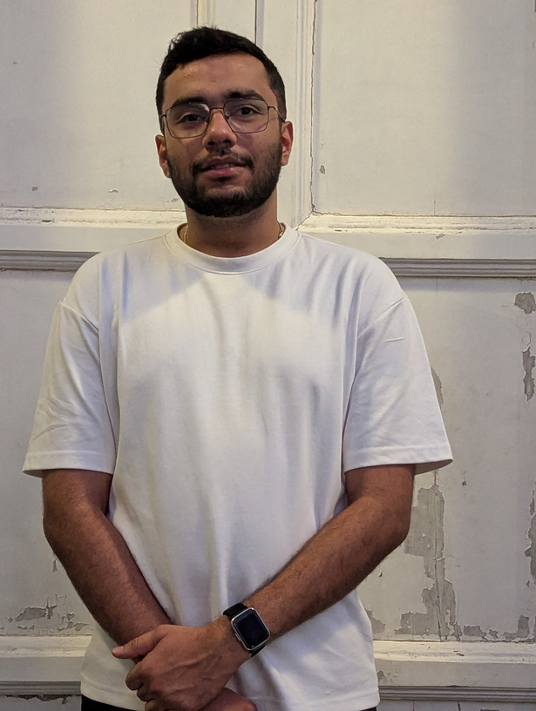

Mobile App Developer– React Native – Deepak Chaudhary
Proposed Position: | Mobile App Developer
Relevant Experience
Associate Engineer • Block Stack Pvt Ltd (Dec 2022 - Current ) Payment application: Built a Payment application for transferring fiat(bank to bank) and crypto currencies(to any crypto wallet globally) integrating features like fund transfer/deposit, bill splitting and scheduling payments. CRM mobile app: Built a Customer relationship management app with features such as account, lead ,contact, calls, meeting, purchase and product for providing user a smooth crm experience for android and Ios devices . Crypto Wallet mobile app: Built a crypto wallet appliction where user can create wallet and hold and transfer crypto currencies, worked on onboarding of new user and crypto transaction app. Collaborated with cross-functional teams, including designers and backend developers, to ensure smooth development, troubleshoot technical issues, and maintain high-quality app performance. Third-Party API Integration – Integrated payment gateways (Razorpay), backend services, and blockchain functionalities into mobile and web applications. Agile methodologies, quickly adapting to changes and delivering results within strict deadlines. Developer Mobile Solution Publicis Sapient • (Nov 2021 - Dec 2022 ) Developed a React Native mobile application for ”The Children’s Place,” a leading children’s apparel and accessories brand, targeting both iOS and Android platforms. Implemented responsive UI components using React Native, ensuring seamless user experiences across different screen sizes and orientations. Utilized Redux to manage state for seamless data flow between components, enhancing the overall user experience.
Name | Deepak Chaudhary
Educational Qualification | B.Tech(CSE) 2017-21
Experience | React Native, ReactJS, Redux, Javascript, Android, Ios,
Experience Summary – 3+ Years
I Experienced React Native Developer with in-depth knowledge of mobile and web application development. Skilled in building scalable, high-performance applications with React Native, React.js, and Redux Toolkit, along with expertise in integrating third-party APIs and managing state efficiently. Strong backend understanding with hands-on experience in Go (Golang), Node.js, and SQL. Having worked in startup environments, I am adept at handling tight deadlines and fast-paced development cycles, quickly adapting to project requirements while maintaining high-quality standards. Passionate about learning and implementing new technologies as per project needs, ensuring optimal solutions and innovation-driven development.
Page ‹#›
Notes:
‹#›

